Slide 1
Sui Course 2023 / Part 6-1

Slide 2
Homogeneous Collections

Slide 3
Agenda
Introduction to Homogeneous Collections
Understanding Vectors
Understanding Tables

Slide 4
Introduction to Homogeneous Collections

Slide 5
What are Homogeneous Collections
Consistent Data Type
This consistency can greatly simplify the coding and debugging process.
Efficiency
This Homogeneous collections allow for certain optimizations because operations can be applied uniformly to all elements. This can result in more efficient code execution.
Notes:
Homogeneous collections are a type of data structure where all elements are of the same type. The term "homogeneous" comes from the Greek words for "same" and "kind", signifying that all elements in the collection belong to the same kind or type.
Here are a couple of key points about homogeneous collections:
Consistent Data Type: Since all elements in the collection are of the same type, you know what type of data to expect when you access elements of the collection. This consistency can greatly simplify the coding and debugging process.
Efficiency: Homogeneous collections allow for certain optimizations because operations can be applied uniformly to all elements. This can result in more efficient code execution.

Slide 6

Types of Homogeneous Collections
Vector
Homogeneous Collections
Table
Notes:
In the context of the Move programming language, there are two main types of homogeneous collections: Vectors and Tables. A Vector in Move is similar to those in other languages such as C++. It's a flexible way to manage a group of a single type, which can be a specific type or a generic type. A Table is a map-like collection that dynamically stores key-value pairs. All keys and all values in a Table must be of the same type.
Homogeneous collections are a fundamental concept in many programming languages and are used in a variety of applications, from managing groups of data in a consistent and predictable way to performing operations on groups of elements efficiently.

Slide 7
Understanding Vectors

Slide 8

What a vector is in Move
1.Dynamic Memory Allocation
2.Single-Type Elements
3.Basic Operations
4.Homogeneity
Notes:
In computer science, a vector is a dynamic array or a resizable array. It's a type of data structure that can hold elements of a single type and can dynamically adjust its size as elements are added or removed.
In the context of the Move programming language, a Vector is similar to those in other languages such as C++. It's a flexible way to dynamically allocate memory at runtime and manage a group of a single type, which can be a specific type or a generic type.
Here's a more detailed look at vectors in Move:
Dynamic Memory Allocation: Unlike static arrays, vectors in Move can adjust their size during the program's runtime. This means you can add elements to a vector or remove elements from it as needed, without having to know the vector's size at compile time.
Single-Type Elements: All elements in a vector are of the same type. This type can be a specific type, like an integer or a string, or it can be a generic type.
Basic Operations: Vectors support several operations, such as creating a new vector, adding an element to the end of the vector (push_back), removing an element from the end of the vector (pop_back), and getting the size of the vector (length).
Homogeneity: While a vector defined with a generic type can accept objects of an arbitrary type, all objects in the collection still must be the same type. This means the collection is homogeneous.
A vector is an important data structure in Move and other programming languages due to its flexibility and efficiency for managing collections of data.

Slide 9

Vector Comparison: Move vs C++
 | Name | Move | Other languages such as C++
 | Dynamic Size
 | Homogeneous Elements
 | Accessing Elements
 | Memory Allocation
 | Specific and Generic Types
 | Mutability | In Move, on the other hand, to maintain resource safety, vectors are immutable. You can add or remove elements, but you cannot change an element that is already in the vector. | In C++, once an object is added to a vector, you can modify that object directly through the vector.
Notes:
A Vector in Move shares many similarities with vectors in other languages such as C++. Here are some comparisons:
Dynamic Size
Both Move and C++ vectors are dynamic arrays, meaning that they can change size at runtime. You can add elements to or remove elements from both types of vectors as needed.
Homogeneous Elements
Both Move and C++ vectors are homogeneous collections, meaning they can only contain elements of a single type. This means, for instance, that a vector of integers can only contain integers.
Accessing Elements
In both Move and C++, you can access elements in a vector by their index. The first element is at index 0, the second element is at index 1, and so on.
Memory Allocation
Both Move and C++ vectors handle memory allocation automatically. When you add an element to a vector and there's not enough space, the vector will automatically allocate more memory to accommodate the new element.
Specific and Generic Types
Both Move and C++ vectors can be of a specific type or a generic type. For instance, in C++, you can have a std::vector<int> which can only contain integers, or a std::vector<T> which can contain elements of any type T. Similarly, in Move, you can have a vector<Widget> which can only contain Widget objects, or a vector<T> which can contain elements of any type T.
However, it's important to note that even if a vector is of a generic type, it can only contain elements of the same type. For example, if you create a vector<T> and add an integer to it, you can only add more integers to that vector, not strings or any other type​1​.
Mutability
One key difference between Move and C++ vectors is in how they handle mutability. In C++, once an object is added to a vector, you can modify that object directly through the vector. In Move, on the other hand, to maintain resource safety, vectors are immutable. You can add or remove elements, but you cannot change an element that is already in the vector.
Overall, while vectors in Move and C++ share many similarities, the differences mainly stem from Move's design as a language for safe and predictable programming on the blockchain.

Slide 10
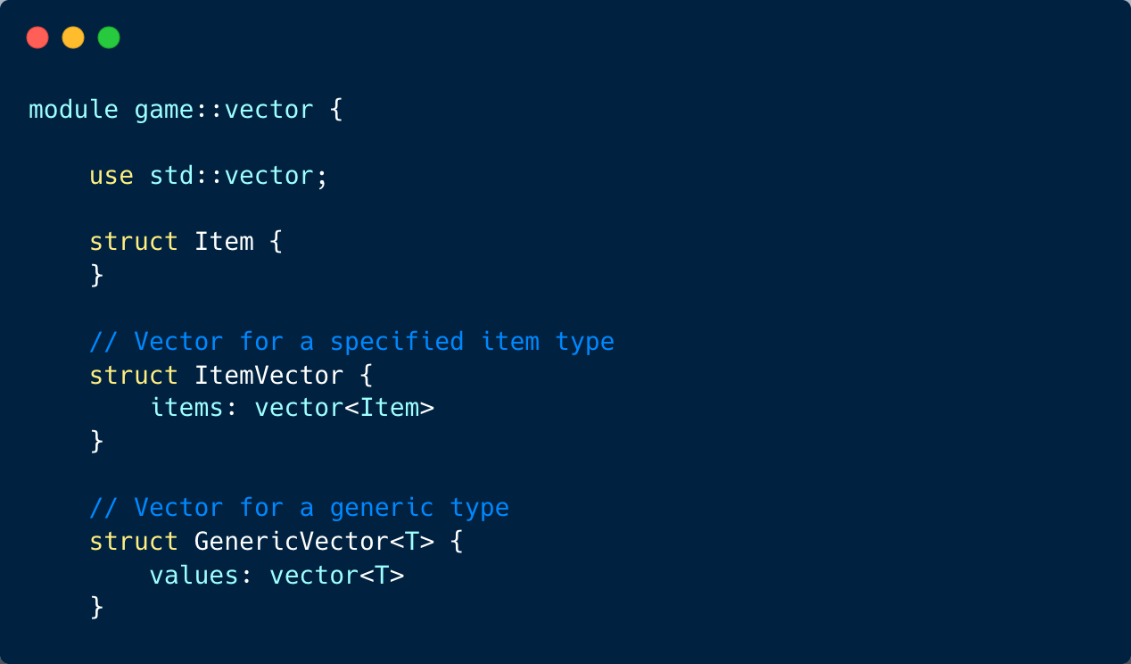
Vector Code Sample
Notes:
This code defines a module called game::vector, which provides functionality for working with vectors (arrays) of items in a game context.
Item struct: This represents a generic item in the game. It serves as a placeholder for any specific item type that the game may have.
ItemVector struct: This is a specialized vector that holds Item instances. It acts as a collection to store multiple Item objects.
GenericVector<T> struct: This is a generic vector that can hold elements of any type T. It is a versatile data structure that can store any data type, not just Item instances.
The module provides the following functions:
create<T>(): GenericVector<T>: This function creates and returns a new, empty GenericVector that holds elements of type T.
put<T>(vec: &mut GenericVector<T>, value: T): This function inserts a value of type T into the specified GenericVector.
remove<T>(vec: &mut GenericVector<T>): T: This function removes and returns the last element from the GenericVector of type T.
size<T>(vec: &mut GenericVector<T>): u64: This function returns the size (number of elements) of the GenericVector of type T.
These data structures and functions provide a convenient way to manage collections of items in a game, allowing for flexible and efficient storage and retrieval of game-related data.

Slide 11
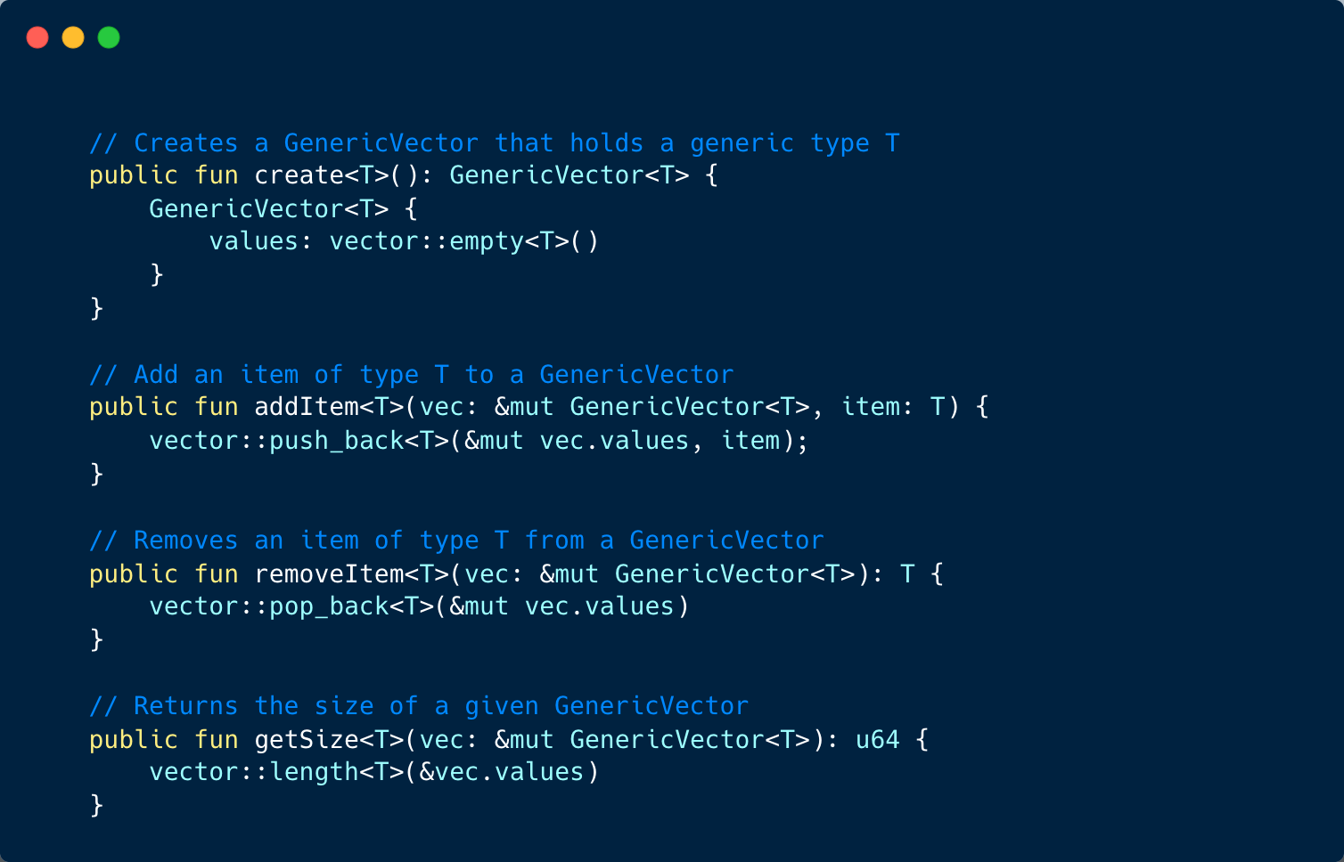
Vector Code Sample
Notes:
This code defines a module called game::vector that provides functions to work with a generic vector, GenericVector, in a game context.
create<T>(): GenericVector<T>: This function creates and returns a new, empty GenericVector that can hold elements of type T. It initializes the vector with an empty collection of T elements.
addItem<T>(vec: &mut GenericVector<T>, item: T): This function adds an item of type T to the specified GenericVector. It appends the item to the end of the vector.
removeItem<T>(vec: &mut GenericVector<T>): T: This function removes and returns the last item of type T from the GenericVector. It effectively pops the last element from the vector.
getSize<T>(vec: &mut GenericVector<T>): u64: This function returns the size (number of elements) of the given GenericVector of type T.
These functions provide basic functionality to manage a generic vector in a game context. Game developers can use these functions to create, add, remove, and get the size of a vector containing any type of game-related data. It offers flexibility and convenience in handling collections of elements in the game's logic.

Slide 12
Understanding Tables

Slide 13
What a table is in Move
Dynamic Storage
Handle System
Homogeneous Collection
Ability Constraint
Notes:
In the context of the Move programming language, a Table is a type of homogeneous collection that behaves like a map, storing key-value pairs. However, it differs from traditional map collections in the way it stores keys and values.
Here are some key points about a Table in Move:
Dynamic Storage: A Table dynamically stores key-value pairs. This means that the data is not stored within the Table value itself, but is stored using Sui's object system.
Handle System: The Table struct acts as a handle into the object system, which is used to retrieve the keys and values. This means that the Table itself does not contain the data, but it provides a way to access the data stored in the object system.
Homogeneous Collection: Like other homogeneous collections, a Table in Move requires all keys and all values to be of the same type. This can either be a specific type or a generic type.
Ability Constraints: The key type of a Table must have the ability constraint of copy + drop + store, and the value type must have the ability constraint of store. This ensures that keys and values have specific abilities that allow them to be used effectively within the Table.
In summary, a Table in Move is a powerful data structure that provides dynamic, type-safe storage of key-value pairs, with the capability to enforce specific abilities on the keys and values it stores. This makes it a valuable tool for many kinds of programming tasks in the blockchain context, especially those requiring efficient, flexible, and type-safe data storage and retrieval​.

Slide 14
Table Comparison: Move vs Map
 | Name | Move | Map
 | Storage | In a Table in Move, the keys and values are not stored within the Table value. Instead, they are stored using Sui's object system. The Table struct acts only as a handle into the object system to retrieve those keys and values. | Traditional map collections usually store their key-value pairs directly within the map object itself.
 | Type Constraints | It is a homogeneous collection where all keys and all values must be of the same type. | Traditional map collections can often store heterogeneous data, meaning keys and values can be of different type
 | Ability Constraints | A Table in Move also enforces ability constraints on its keys and values. The key type of a Table must have the ability constraint of copy + drop + store, and the value type must have the ability constraint of store. | N/A
Notes:
In the Move programming language, a Table can be considered as a form of map collection, but it has distinct characteristics that set it apart from traditional map collections you might find in other programming languages.
Storage: Traditional map collections usually store their key-value pairs directly within the map object itself. However, in a Table in Move, the keys and values are not stored within the Table value. Instead, they are stored using Sui's object system. The Table struct acts only as a handle into the object system to retrieve those keys and values.
Type Constraints: Traditional map collections can often store heterogeneous data, meaning keys and values can be of different types. However, in a Table in Move, it is a homogeneous collection where all keys and all values must be of the same type.
Ability Constraints: A Table in Move also enforces ability constraints on its keys and values. The key type of a Table must have the ability constraint of copy + drop + store, and the value type must have the ability constraint of store. This is not a feature commonly seen in traditional map collections in other languages.
In summary, while Tables in Move and traditional map collections both store key-value pairs, the way they store data, the type constraints they enforce, and the ability constraints in the case of Tables in Move make them different from each other​1​.

Slide 15
Copy Drop Store
Copy
This ability allows a value
of the type to be duplicated.
In the context of a Table,
the keys must have this ability,
meaning they can be copied.
Drop
This ability allows a value of the
type to be discarded. For a Table,
this also applies to the keys,
indicating they can be discarded.
Store
This ability allows a value of the type to be stored in global storage (i.e., it can persist across transactions). For a Table, both keys and values must have this ability.
Notes:
In the Move programming language, types can be associated with certain abilities that dictate how they can be used. These abilities include copy, drop, and store.
Let's break down these abilities in the context of the Table type:
copy: This ability allows a value of the type to be duplicated. In the context of a Table, the keys must have this ability, meaning they can be copied.
drop: This ability allows a value of the type to be discarded. For a Table, this also applies to the keys, indicating they can be discarded.
store: This ability allows a value of the type to be stored in global storage (i.e., it can persist across transactions). For a Table, both keys and values must have this ability.
In summary, the key type in a Table must have the copy + drop + store abilities, and the value type must have the store ability. This means keys can be copied and discarded, and both keys and values can be stored in the global storage. This constraint ensures that the Table can function correctly as a key-value storage system.

Slide 16
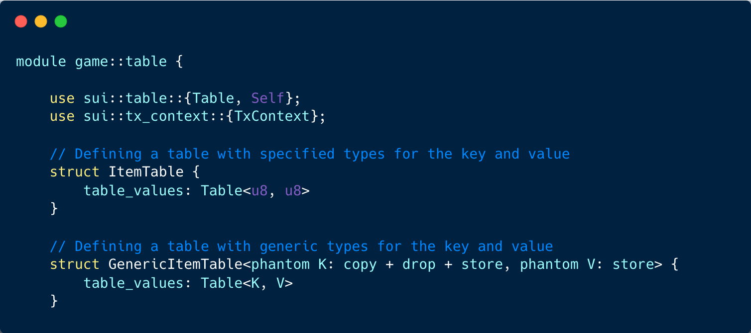
Table Code Sample
Notes:
This code defines a module called game::table that provides structures to work with tables in a game context.
struct ItemTable: This structure defines a table called ItemTable with specified types for the key and value. In this case, both the key and value are of type u8.
struct GenericItemTable<phantom K: copy + drop + store, phantom V: store>: This structure defines a generic table called GenericItemTable with generic types for the key and value. The phantom keyword indicates that the types K and V are only used for compile-time type checking and do not consume any memory at runtime. The copy, drop, and store traits specify the requirements for the types that can be used as keys and values in the table.
The game::table module does not include any functions, so it mainly serves as a data structure definition for handling tables in a game context. Game developers can use these table structures to create and manage tables with specific key-value data types or generic key-value data types. Tables are useful for organizing and storing game-related data in key-value pairs, providing efficient access and lookup capabilities.

Slide 17
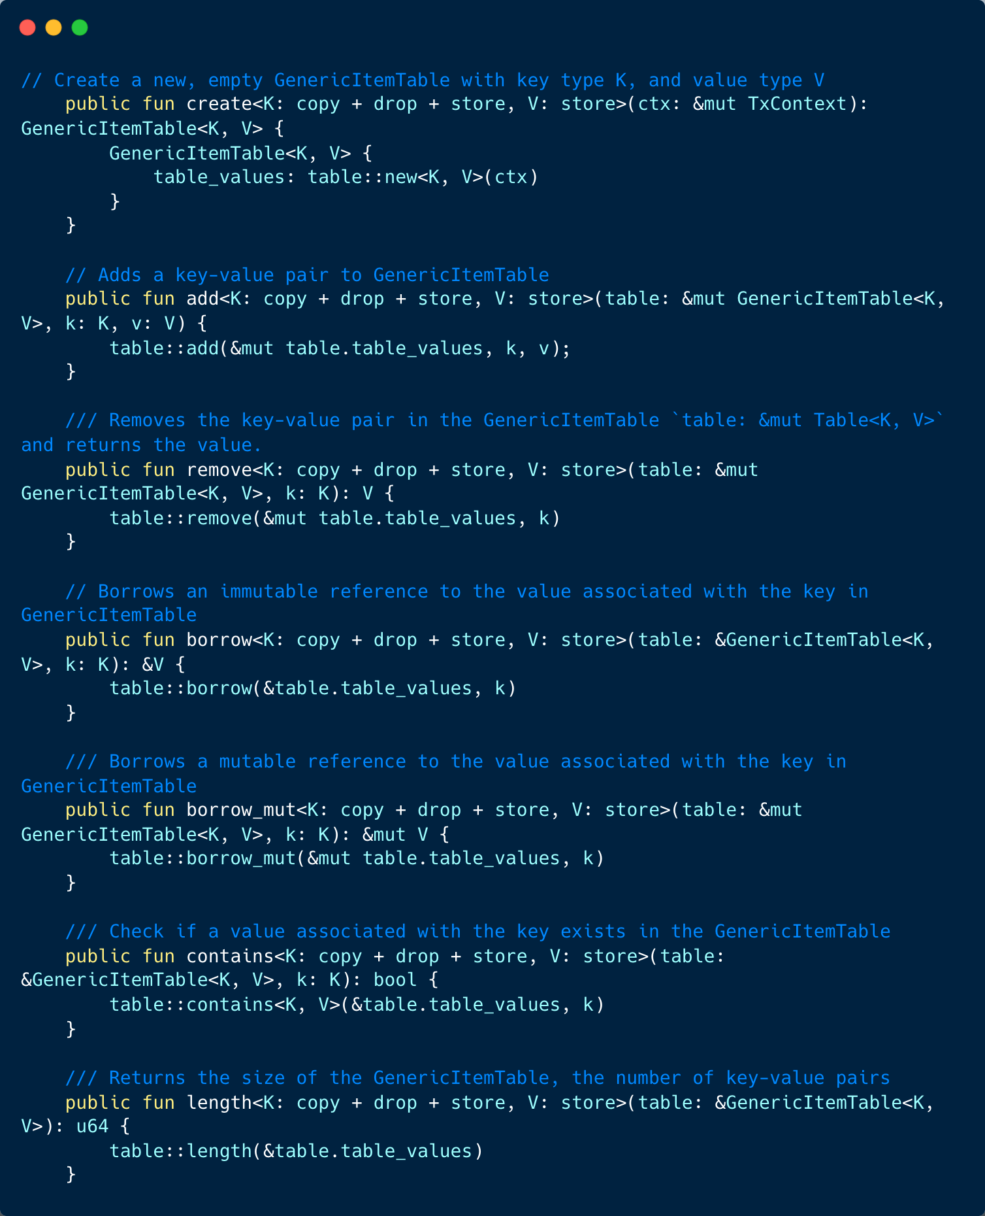
Table Code Sample
Notes:
This code provides functions to interact with a generic table in a game context. The table is called GenericItemTable and allows storing key-value pairs with generic key and value types.
public fun create<K: copy + drop + store, V: store>(ctx: &mut TxContext): GenericItemTable<K, V>: This function creates a new, empty GenericItemTable with the specified key type K and value type V. It takes a mutable reference to a transaction context ctx and returns the newly created GenericItemTable.
public fun add<K: copy + drop + store, V: store>(table: &mut GenericItemTable<K, V>, k: K, v: V): This function adds a key-value pair to the GenericItemTable. It takes a mutable reference to the table table, a key of type K (passed by value), and a value of type V (passed by value).
public fun remove<K: copy + drop + store, V: store>(table: &mut GenericItemTable<K, V>, k: K): V: This function removes the key-value pair associated with the given key k from the GenericItemTable and returns the value V.
public fun borrow<K: copy + drop + store, V: store>(table: &GenericItemTable<K, V>, k: K): &V: This function borrows an immutable reference to the value associated with the given key k in the GenericItemTable.
public fun borrow_mut<K: copy + drop + store, V: store>(table: &mut GenericItemTable<K, V>, k: K): &mut V: This function borrows a mutable reference to the value associated with the given key k in the GenericItemTable.
public fun contains<K: copy + drop + store, V: store>(table: &GenericItemTable<K, V>, k: K): bool: This function checks if a value associated with the given key k exists in the GenericItemTable and returns a boolean indicating the result.
public fun length<K: copy + drop + store, V: store>(table: &GenericItemTable<K, V>): u64: This function returns the size of the GenericItemTable, which corresponds to the number of key-value pairs it currently contains.

